Slide 1
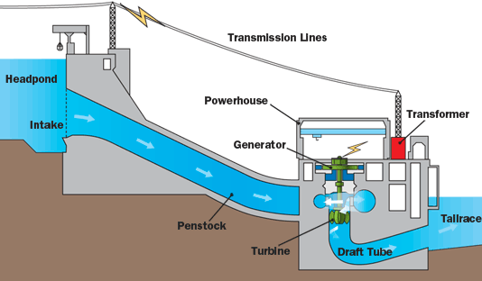
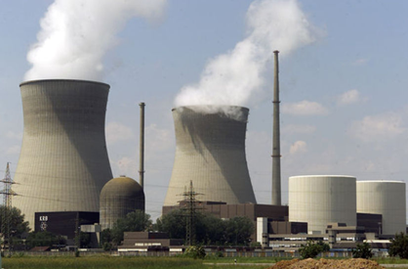
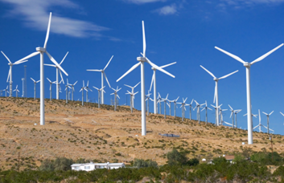
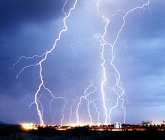
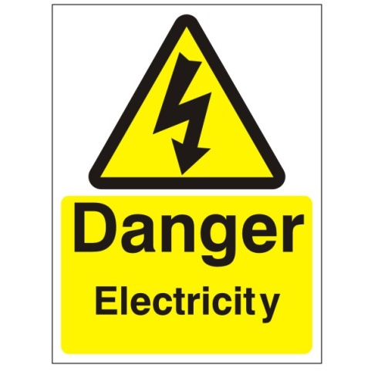
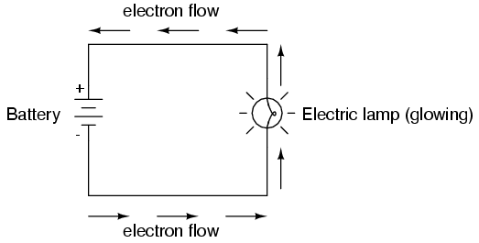
Resistance
Resistance
Loads
Conductors
Superconductors
Ohm’s Law
Practice Questions
More Examples

Slide 2
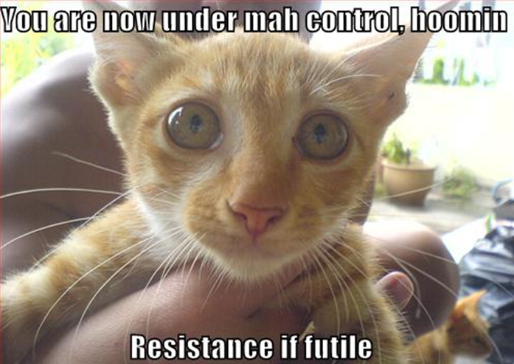
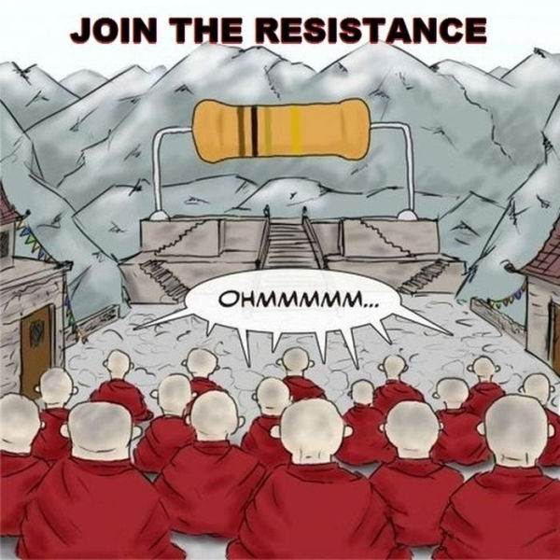
Electrical Resistance

Slide 3
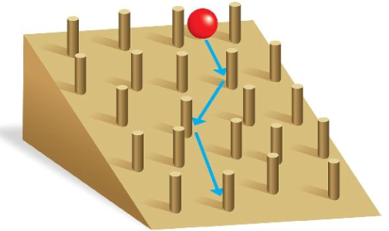
KEY TERM – RESISTANCE (R)
When the electrons pass into a device (load) they bump into substances within the object (ions, other electrons, etc.)
These bumps interfere with the electron flow because they get in the way
Electrical resistance is a property of a substance that hinders electric current and converts electrical energy into other forms such as heat
Can you think of an example?

Slide 4
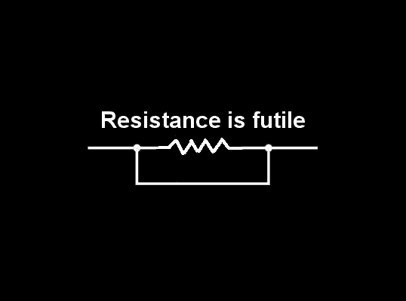
Loads
A resistor or any other device that transforms electrical energy into heat, motion, sound or light
E.g. Watch, flashlight, light, computer, etc.

Slide 5
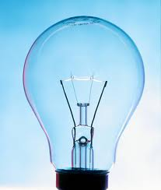
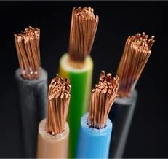
Resistance Continued
Some substances resist the flow of electrons more than others
Light bulb filaments are very good resistors and therefore slow down a lot of electrons.
The energy from the electrons can then make the filaments glow making the light bulb light up
Copper is a very poor resistor. Why does this property make copper an efficient electrical wire.

Slide 6
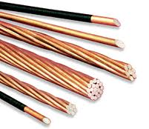
Conductors
A substance that carries electrical energy without much resistance (little loss of electricity)
Substances such as light bulbs are designed to be very poor conductors and therefore, a lot of energy from the electrons is lost near them making them glow

Slide 7
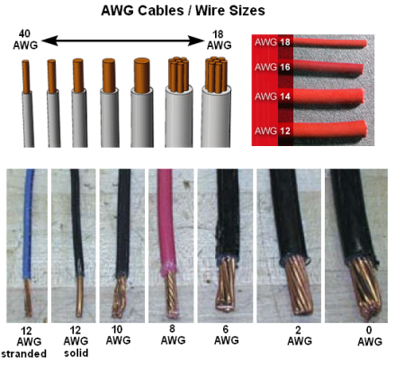
What affects the resistance of a wire?
The type of material
The length (a longer wire has a greater resistance)
The diameter (a wire with a larger diameter has a lower resistance)
The temperature (a hotter wire has a greater resistance)

Slide 8
Superconductors
When electric charge can flow through a material with no resistance, the material is called a superconductor
Obtained by cooling to almost absolute zero
Vastly increases the efficiency of the wire because all the energy is carried forward (none is lost)
Used in materials that carry a lot of current (a lot of electrons)
E.g. Magnet at CERN used to accelerate particles

Slide 9
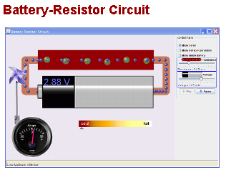
Ohm’s Law
Free electrons tend to move through conductors with some degree of friction, or opposition to motion. This opposition to motion is more properly called resistance.
The symbol for resistance is Ω or ohm’s.
Try It →

Slide 10
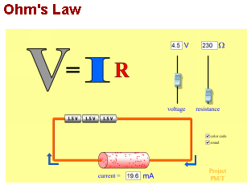
Ohm’s Law
As resistance increases, current decreases
Try It →
The higher the resistance the more the electrons will slow down as they pass through. As the electrons slow down, their energy can be taken to do work (e.g. Light up, move a motor, etc.)
The formula is: V = I X R
Where V = voltage, I = current and R = resistance

Slide 11
Question
What is the voltage drop across a 100 watt light bulb if the resistance is 150 Ω and the current is 0.8A?
V = I X R

Slide 12
Question
What is the voltage drop across a 100 watt light bulb if the resistance is 150 Ω and the current is 0.8A?
V = I X R
V = 0.8 A X 150 Ω
V = 120 V
Therefore the voltage drop is 120 V

Slide 13
Recall and Extend
What gives a light its brightness is the Power (kW)
P = V X I
Remember, V = I X R and if we increase the resistance, we decrease the current. Why does V stay the same???? – Think about what V is!
If current decreases, power decreases (P=V X I)
Less power means your load can’t do its job as well

Slide 14
Example
E.g. Which Bulb (A or B) has the greater Electrical Power? Voltage across each bulb = 5 V.
Bulb A has a resistance of 2 ohm’s while Bulb B has a resistance of 4 ohm’s
Bulb A:
I = V/R =
P = V X I =
Bulb B:
I = V/R =
P = V X I =

Slide 15
Example
E.g. Which Bulb (A or B) has the greater Electrical Power? Voltage across each bulb = 5 V.
Bulb A has a resistance of 2 ohm’s while Bulb B has a resistance of 4 ohm’s
Bulb A:
I = V/R = 5 V/2 Ω = 2.5 A
P = V X I = 5 V X 2.5 A = 12.5 W
Bulb B:
I = V/R = 5 V/4 Ω = 1.25 A
P = V X I = 5 V X 1.25 A = 6.25 W
Since Bulb B has a lower Power, it will glow less than Bulb A

Slide 16
Calculating Resistance in a Circuit
Solve the circuits calculating the voltage, current and any unknown resistances.
**R_{T} Series = R₁ + R₂ + … + R_{n} → simply add the resistances found in the circuit
**R_{T} Parallel =

